Slide 1
Path Selection of Garbage Truck using A* Algorithm and Population Density Score
EKA HIMAWANTO- 1103130286

Slide 2
Background of the problem
Whats the problem :
The truck driver in many cities does not have a map showing the best route to transport garbage
Garbage truck driver in major cities usually pick the shorest route and drive through populated area
Why is that a problem :
The smells of the garbage in the garbage truck is very bad and the water that the garbage produce can make people uncomfortable

Slide 3
Solution
Make an application use the Path search algorithm and score that represents a population density level to help the driver choose the shortest path with avoid or minimized choose the path with high population area .
Path search algorithm that use is A* Algorithm
Scale of population density used for Score that represents a population density level
Notes:
Membuat aplikasi menggunakan algoritma pencarian jalur dan di bantu dengan skor yang merepresentaikan kepadatan penduduk untuk membantu supir truk sampah dalam menentukan jalur terpendek dengan menghindari atau meminimalkan melewati jalur dengan kepadtan penduduk yang tinggi tetapi sesuai dengan jatah bahan bakar yang di sediakan
A* saya pilih karna A* adalah algoritma pencarian jalur yang efisien karna menggunakan nilai heuristic diman algoritma ini akan membuang langkah – langkah yang tidak perlu dengan pertimbangan bahwa langkah – langkah yang dibuang sudah pasti merupakan langkah yang tidak akan mencapai solusi

Slide 4
How to know it can?
Compare the Path generated A* Algorithm use population density score with A* not use population density score.
Notes:
Bagaimana saya mengetahui bahwaalgoritma a* dengan di bantu skor kepadatan penduduk dalam pencarian jalur dapat memilih jalur yang optimal dengan tidak atau meminimalkan melewati jalur dengan skor kepadatan penduduk tinggi

Slide 5
Limitation Of Problem
Only choose routes from TPST to TPA
The System Collection the Garbage that be selected is Collection system indirectly.
Only calculate the Distance .
Do not pay attention to traffic jams.
Do not pay attention to road condition
Use Arterial roads for the biggest road and road that has a width of 4 meters with a road side of 50 cm for the smallest road .

Slide 6
Scale of population density
No | Population Density per km² | Score
1. | <500 | 1
2. | 500 – 1249 | 2
3. | 1250 – 2499 | 3
4. | 2500 – 3999 | 4
5. | 4000 – 5999 | 5
6. | 6000 – 7499 | 6
7. | 7500 – 8499 | 7
8. | >8500 | 8
Source : KLASIFIKASI PERKOTAAN DAN PERDESAAN DI INDONESIA ( Buku 2 : Pulau Jawa )

Slide 7
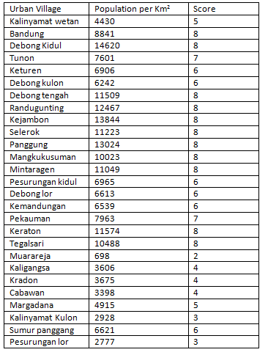
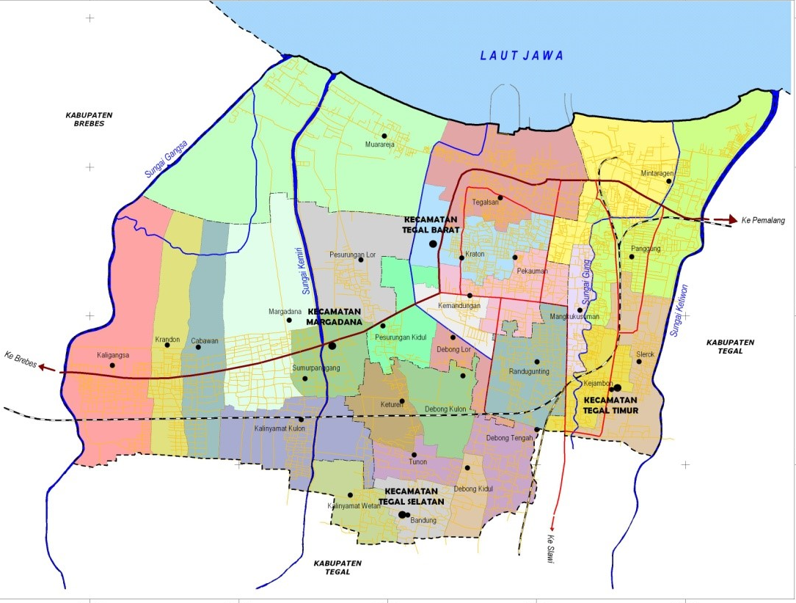
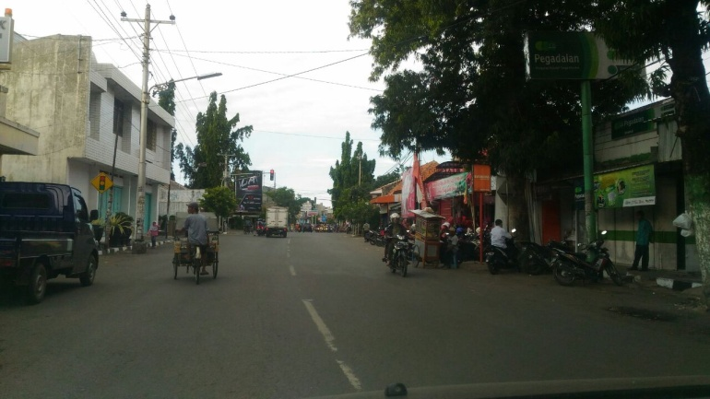
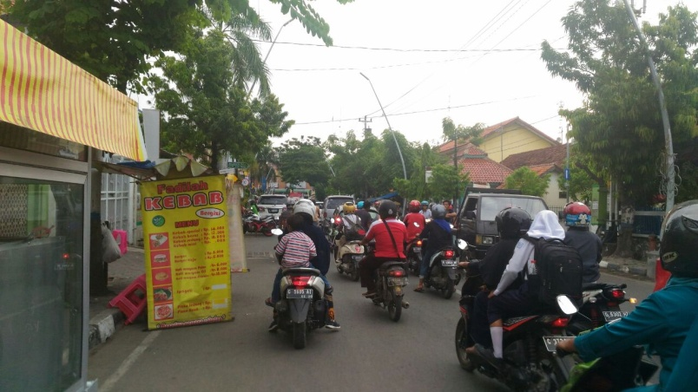
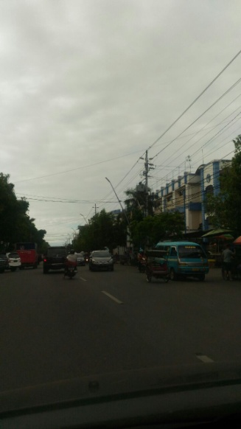
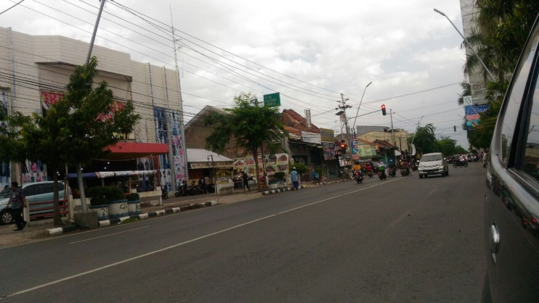
Road network
Jl setiabudi (Mintaragen)
Jl Kartini (Mangkukusuman)
Jl Ar hakim ( Randugunting )
Jl Ahmad yani (Mangkukusuman)
Source : Peta Rencana tata ruang wilayah Kota Tegal

Slide 8
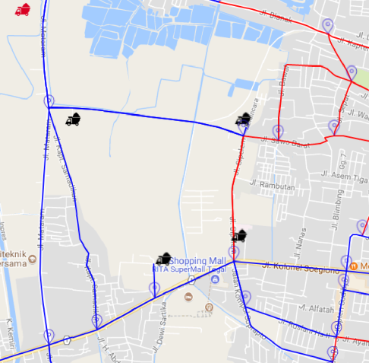
Example
F(x)= 3.563
TPA
F(x) =3.629(3)
Solution :
TPST Sejahtera mandiri – INT 66 – INT 67 – INT 6 – INT 7 – TPA
0.639
INT 7
2.351
1.831
INT 53
TPST sejahtera
Mandiri
F(x) =0.768+ 1.831
= 2.599(8)
F(x)=0.155+0.635+2.253
=3.043(6)
0.768
F(x) =0.155 + 2.351
=2.505 (8)
F(x) =3.984(7)
F(x) =3.629(5)
0.155
F(x) =4.810(6)
1.649
0.829
INT 16
0.635
INT 66
F(x) =4.031(5)
0.484
0.342
0.697
INT 15
INT 67
INT 17
INT 14
0.371
F(x) =4.681(6)
INT 6
F(x) =3.157(6)
INT 13
INT 2
0.808

Slide 9
Result A* algorithm with population density score
TPST | Distance (km) | Red Distance (km) | Fuel (liter)
TPST Mulya jaya | 4.972 | 0 | 1.308
TPST Al hikmah | 3.153 | 0 | 0.830
TPST Fajar jaya | 4.687 | 0 | 1.233
TPST Rapi jaya | 3.018 | 0 | 0.794
TPST sejahtera mandiri | 3.563 | 0.155 | 0.938
TPST bersama kita maju | 2.147 | 0 | 0.565
TPST bandeng sari | 3.553 | 1.701 | 0.935
TPST melati jaya | 6.383 | 1.624 | 1.68
TPST Sumbodro | 7.248 | 2.287 | 1.907
TPST arum karya | 5.328 | 0.46 | 1.402
TPST bahari asri | 5.329 | 0 | 1.379
TPST keminclong | 0.814 | 0 | 0.214

Slide 10
Evaluation
License plate | Type | TPST
G 9534 AE | Dump Truck | TPST Arum Karya
 |  | TPST Melati jaya
 |  | TPST Sumbodro
G 9530 WE | Dump Truck | TPST Sejahtera mandiri
 |  | TPST Rapijaya
 |  | TPST bersama kita maju
 |  | TPST keminclong
 |  | TPST bandeng sari
G 9540 E | Dump Truck | TPST bahari asri
 |  | TPST fajar jaya
 |  | TPST Mulya jaya
Source : Lia Kurniawati, Laporan Kerja Praktek SISTEM PENGELOLAAN SAMPAH KOTA TEGAL

Slide 11
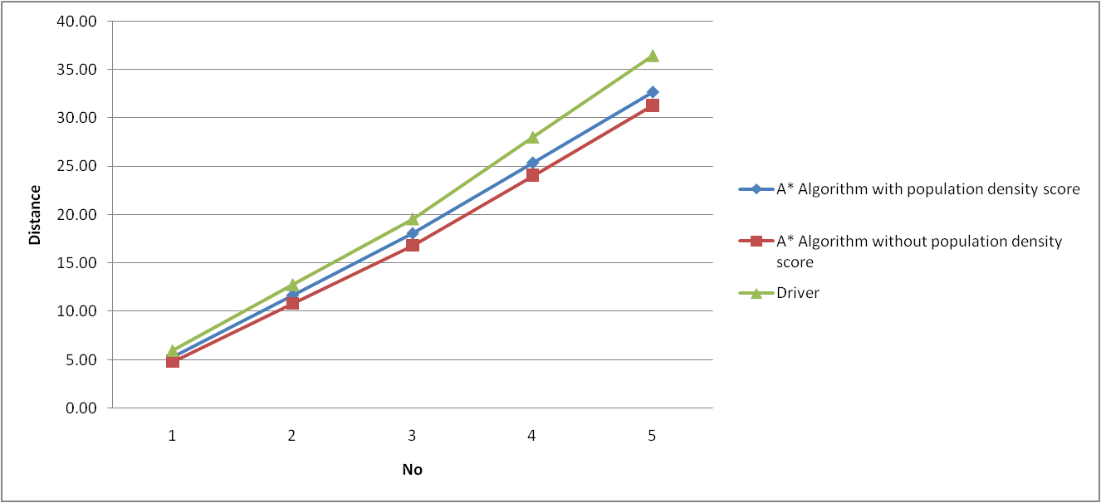
Evaluation
Truck G 9543 AE
No | Route | Distance(km)
 |  | A* With Population Density score | A* Without Population Density score | By Driver
1 | TPST Arum Karya – TPA | 5.328 | 4.823 | 5.99
2 | Route 1 – TPA – TPST Melati jaya | 11.711 | 10 .81 | 12.78
3 | Route 2 – TPST Melatijaya – TPA | 18.094 | 16.797 | 19.57
4 | Route 3 – TPA – TPSA Sumbodro | 25.374 | 24.045 | 27.99
5 | Route 4 – TPST sumbodro - TPA | 32.662 | 31.293 | 36.41
Fuel |  | 8.58 | 8.235 | 9.58

Slide 12
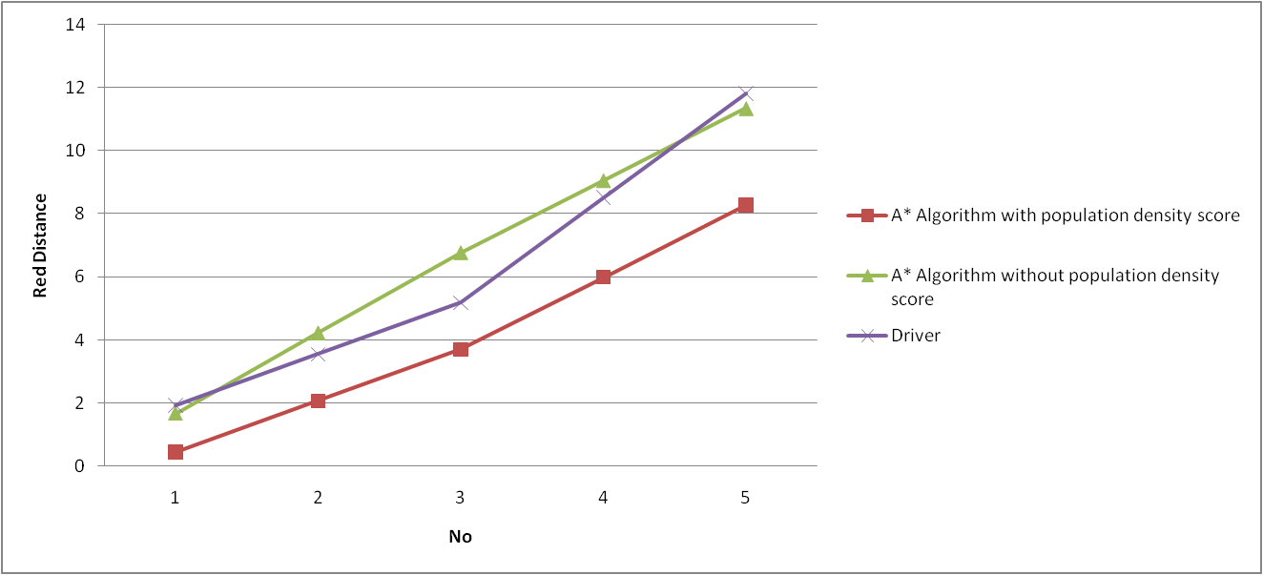
Evaluation
Truck G 9543 AE
No | Route | Red Distance(km)
 |  | A* With Population Density score | A* Without Population Density score | By Driver
1 | TPST Arum Karya – TPA | 0.460 | 1.675 | 1.936
2 | Route 1 – TPA – TPST Melati jaya | 2.084 | 4.222 | 3.56
3 | Route 2 – TPST Melatijaya – TPA | 3.708 | 6.769 | 5.184
4 | Route 3 – TPA – TPSA Sumbodro | 5.995 | 9.056 | 8.511
5 | Route 4 – TPST sumbodro - TPA | 8.282 | 11.343 | 11.838

Slide 13
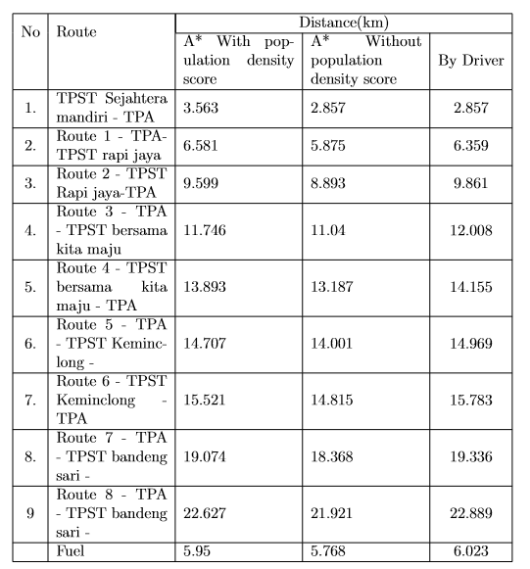
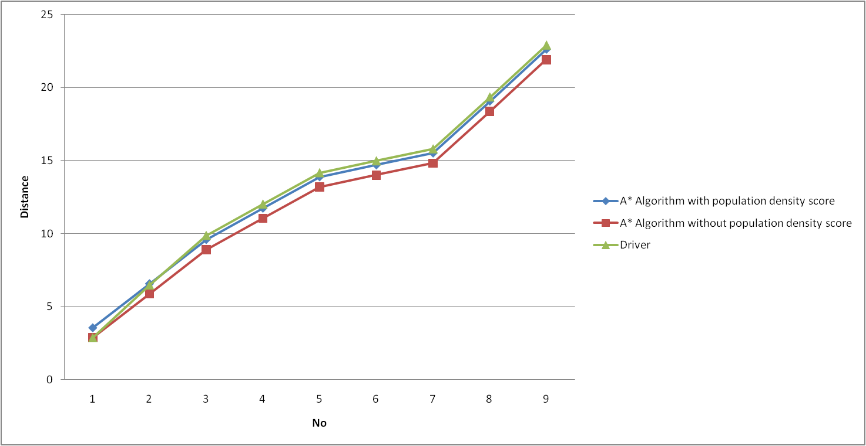
Evaluation
Truck G 9530 WE
No | Route | Distance(km)
 |  | A* With Population Density score | A* Without Population Density score | By Driver
1 | TPST sejahtera mandiri– TPA | 3.563 | 2.857 | 2.857
2 | Route 1 – TPA – TPST Rapi jaya | 6.581 | 5.857 | 6.359
3 | Route 2 – TPST rapijaya – TPA | 9.599 | 8.893 | 9.861
4 | Route 3 – TPA – TPST bersama kita maju | 11.746 | 11.04 | 12.008
5 | Route 4 – TPST bersama kita maju - TPA | 13.893 | 13.187 | 14.155
6 | Route 5 – TPA – TPST keminclong | 14.707 | 14.001 | 14.969
7 | Route 6 – TPST keminclong - TPA | 15.521 | 14.815 | 15.783
8 | Route 7 – TPA - TPST bandeng sari | 19.074 | 18.368 | 19.336
9 | Route 8 – TPST bandeng sari - TPA | 22.627 | 21.921 | 22.889
Fuel |  | 5.95 | 5.768 | 6.023

Slide 14
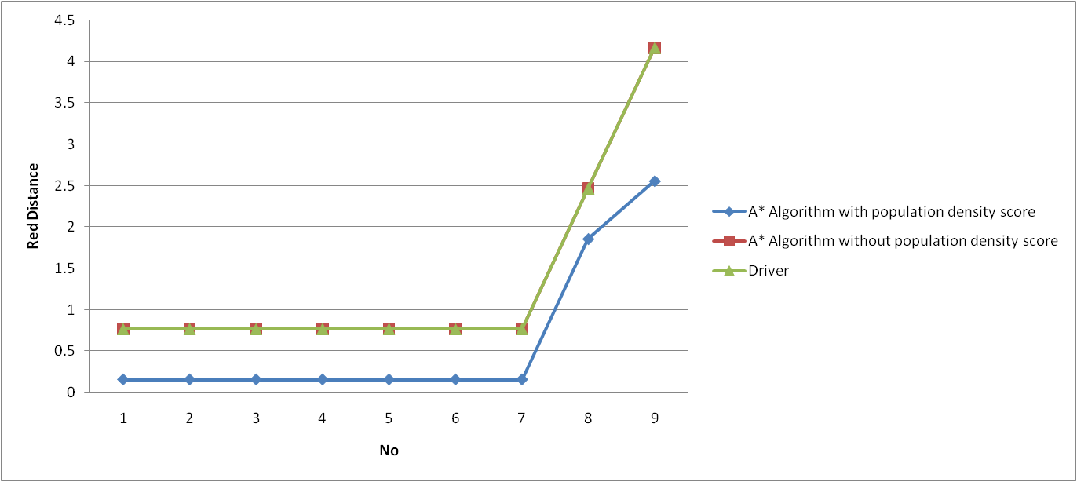
Evaluation
Truck G 9530 WE
No | Route | Red Distance(km)
 |  | A* With Population Density score | A* Without Population Density score | By Driver
1 | TPST sejahtera mandiri– TPA | 0.155 | 0.768 | 0.768
2 | Route 1 – TPA – TPST Rapi jaya | 0.155 | 0.768 | 0.768
3 | Route 2 – TPST rapijaya – TPA | 0.155 | 0.768 | 0.768
4 | Route 3 – TPA – TPST bersama kita maju | 0.155 | 0.768 | 0.768
5 | Route 4 – TPST bersama kita maju - TPA | 0.155 | 0.768 | 0.768
6 | Route 5 – TPA – TPST keminclong | 0.155 | 0.768 | 0.768
7 | Route 6 – TPST keminclong - TPA | 0.155 | 0.768 | 0.768
8 | Route 7 – TPA - TPST bandeng sari | 19.074 | 2.469 | 2.469
9 | Route 8 – TPST bandeng sari - TPA | 1.856 | 4.17 | 4.17

Slide 15
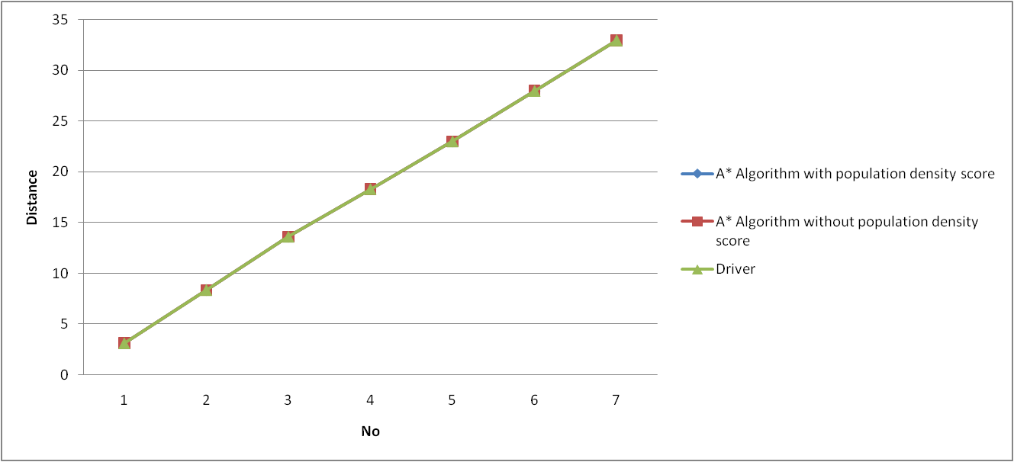
Evaluation
G 9540 E
No | Route | Distance(km)
 |  | A* With Population Density score | A* Without Population Density score | By Driver
1 | TPST Al hikmah– TPA | 3.153 | 3.153 | 3.153
2 | Route 1 – TPA – TPST Bahari asri | 8.392 | 8.392 | 8.392
3 | Route 2 – TPST Bahari asri– TPA | 13.631 | 13.631 | 13.631
4 | Route 3 – TPA – TPSA Fajar jaya | 18.318 | 18.318 | 18.318
5 | Route 4 – TPST Fajar jaya- TPA | 23.005 | 23.005 | 23.005
6 | Route 5 – TPA – TPST Mulya jaya | 27.977 | 27.977 | 27.977
7 | Route 6 – TPST Mulya jaya - TPA | 32.949 | 32.949 | 32.949
Fuel |  | 8.671 | 8.671 | 8.671

Slide 16
Summary
F(x)= 3.563
Red path : 0.155
F(x)= 2.857
Red path : 0.768
INT 53
F(x) =0.768+ 1.831
= 2.599(8)
0.768
F(x) =0.155 + 2.351
=2.505 (8)
0.155
INT 66

Slide 17
Conclusion
TPST in area with population density score < 8 A* algorithm with population density score always choose shortest path like A* algorithm without population density score
TPST in area with population density = 8 A* algorithm with population density score not always choose shortest path because A* algorithm with population density score must be find shortest path to exit area with population density score = 8
A * Algorithm with population density scores can find a path with shortest red paths than A* Algorithm without population density score and the path selected by garbage truck drivers

Slide 18
Suggestion
In this final project only use the length of the road and population density score not use travel time . Travel time can be considered with several factors there is :
Road Condition
The number of traffic lights
Traffic lights in intersection
It is hoped that further research can be added Travel time.

